Slide 1


NEXT GEN EMPLOYABILITY PROGRAM
CREATING A FUTURE-READY WORKFORCE
Student Name :
AJAY SAH
Student ID :
College Name :
PURNEA COLLEGE OF ENGINEERING,PURNEA
STU61fe4d04731cd1644055812

Slide 2
CAPSTONE PROJECT SHOWCASE
Project Title
Building Customer Segmentation Models using Python
Abstract | Problem Statement | Project Overview | Proposed Solution | Technology Used | Modelling & Results | Conclusion | Q&A

Slide 3
Abstract
1
This project focuses on enhancing marketing strategies and boosting sales in online retail through customer segmentation and recommendation systems.
2
Utilizing a transactional dataset from the UCI Machine Learning Repository spanning 2010 to 2011, the project employs data preprocessing techniques and feature engineering to derive meaningful customer-centric features, including RFM metrics.
3
Customer segmentation is conducted using the K-means clustering algorithm, enabling the identification of distinct customer groups with unique behaviors and preferences.
4
A recommendation system is developed to suggest top-selling products to customers within each segment, leading to personalized shopping experiences and improved marketing efficacy. Evaluation metrics such as precision, recall, and MAP are utilized to assess the system's performance, highlighting its impact on sales and marketing strategies in the online retail domain.

Slide 4


Problem Statement
In this project, we delve deep into the thriving sector of online retail by analyzing a transactional dataset from a UK-based retailer, available at the UCI Machine Learning Repository. This dataset documents all transactions between 2010 and 2011. Our primary objective is to amplify the efficiency of marketing strategies and boost sales through customer segmentation. We aim to transform the transactional data into a customer-centric dataset by creating new features that will facilitate the segmentation of customers into distinct groups using the K-means clustering algorithm. This segmentation will allow us to understand the distinct profiles and preferences of different customer groups. Building upon this, we intend to develop a recommendation system that will suggest top-selling products to customers within each segment who haven't purchased those items yet, ultimately enhancing marketing efficacy and fostering increased sales.

Slide 5

Project Overview
Objective:
Amplify marketing strategies and boost sales in online retail.
Utilize a transactional dataset from a UK-based retailer (2010-2011).
Implement customer segmentation for targeted marketing.
Develop a recommendation system for personalized product suggestions.
Approach:
Data Analysis:
Analyze transactional dataset from the UCI ML Repository.
Understand customer behaviour and preferences.
Feature Engineering:
Transform transactional data into customer-centric features.
Create new features for customer segmentation.
Customer Segmentation:
Utilize K-means clustering for grouping customers.
Identify distinct customer profiles and preferences.
Recommendation System:
Develop a system to suggest top-selling products.
Tailor recommendations for each customer segment
Expected Outcomes:
Enhanced marketing efficiency through targeted campaigns.
Increased sales by offering personalized product recommendations.
Insights into customer behaviour for future optimizations.

Slide 6
Proposed Solution
Data Exploration and Preprocessing:
Begin by exploring the transactional dataset from the UCI Machine Learning Repository.
Conduct data preprocessing tasks such as handling missing values, outliers, and converting date/time variables.
Perform exploratory data analysis (EDA) to gain insights into the dataset's structure and distribution.
Feature Engineering:
Transform the transactional data into a customer-centric dataset by creating new features.
Derive meaningful features such as Recency, Frequency, and Monetary (RFM) metrics to capture customer behavior.
Introduce additional variables that may represent customer preferences or engagement.
Customer Segmentation:
Apply the K-means clustering algorithm to segment customers into distinct groups based on the engineered features.
Experiment with different numbers of clusters to identify the optimal segmentation.
Analyze the characteristics of each segment to understand the unique profiles and preferences of different customer groups.
Recommendation System Development:
Develop a recommendation system that suggests top-selling products to customers within each segment.
Utilize collaborative filtering, content-based filtering, or hybrid approaches to generate personalized recommendations.
Implement algorithms to ensure the recommendations are relevant and likely to enhance sales.
Evaluation and Optimization:
Evaluate the effectiveness of the customer segmentation and recommendation system using appropriate metrics such as precision, recall, and conversion rate.
Optimize the algorithms and parameters based on the evaluation results to improve performance.
Conduct A/B testing or validation methods to validate the impact of the implemented strategies on marketing efficacy and sales.
Deployment and Integration
Monitoring and Maintenance:
Implement monitoring mechanisms to track the performance of the segmentation and recommendation system over time.
Regularly update the system with new data and retrain the algorithms to adapt to changing customer preferences and market dynamics.

Slide 7
Technology used
Python Programming Language: The entire code is written in Python, indicating that Python is the primary programming language for the project.
2.Libraries and Packages:
NumPy: Used for numerical computing and array manipulation.
Pandas: Utilized for data manipulation and analysis, particularly for handling datasets.
Seaborn and Matplotlib: Employed for data visualization, including creating various plots and charts to visualize data distributions and relationships.
Plotly: Utilized for interactive data visualization, offering features for creating interactive plots.
Scikit-learn: Used for machine learning tasks, including clustering algorithms like K-means.
Tabulate: Likely used for creating formatted tables for presenting results or data.
Yellowbrick: Utilized for visualizing cluster quality metrics such as silhouette scores and elbow plots.
3.Data Preprocessing and Analysis:
StandardScaler: Used for standardizing numerical features to have a mean of 0 and a standard deviation of 1.
IsolationForest: Employed for outlier detection and removal from the dataset.
4.Dimensionality Reduction:
PCA (Principal Component Analysis): Used for dimensionality reduction to reduce the number of features while preserving most of the variance in the data.
5.Clustering and Evaluation:
KMeans: Utilized for clustering the data into distinct groups.
Silhouette Score, Calinski-Harabasz Score, Davies-Bouldin Score: Metrics used for evaluating the quality of clustering results.
KElbowVisualizer, SilhouetteVisualizer: Yellowbrick visualizers used for determining the optimal number of clusters and evaluating cluster quality.
Overall, the technology stack includes a range of Python libraries and packages commonly used for data analysis, machine learning, and visualization tasks.

Slide 8
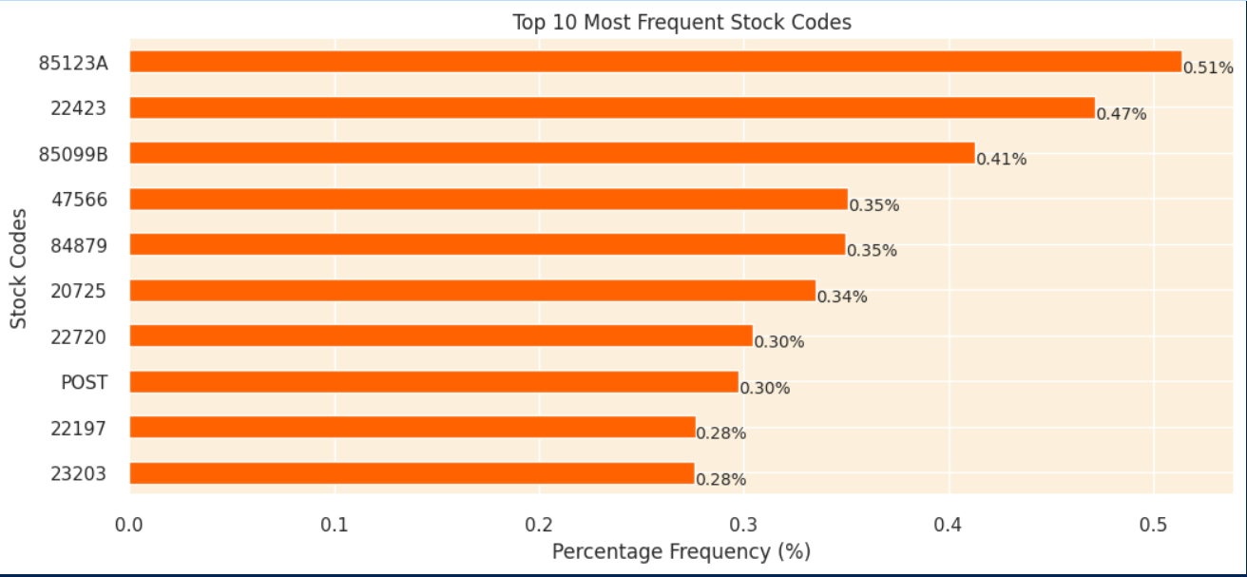
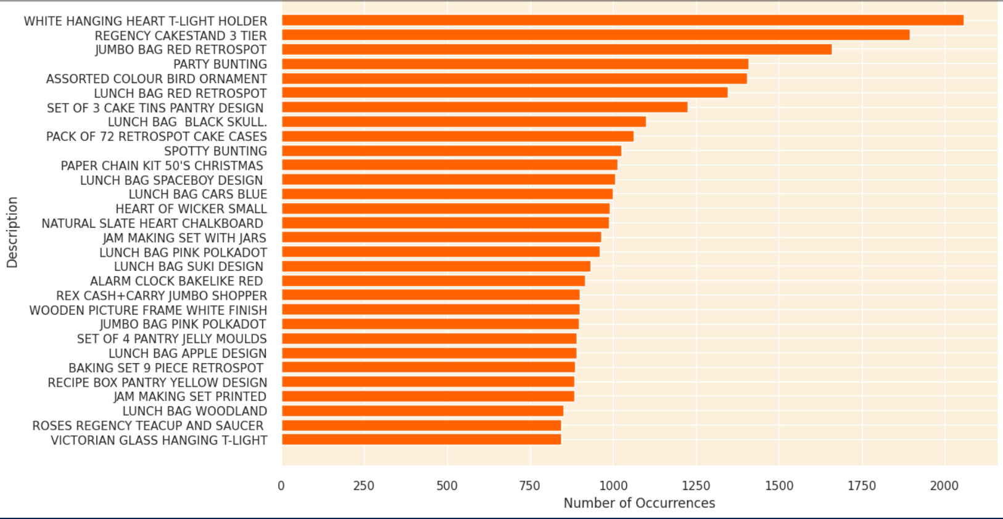
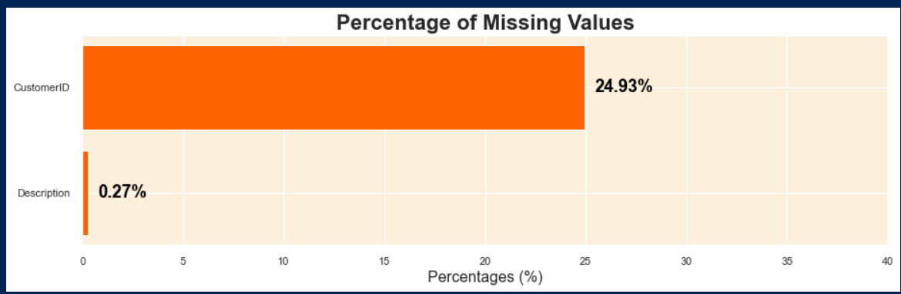
Modelling & Result

Slide 9
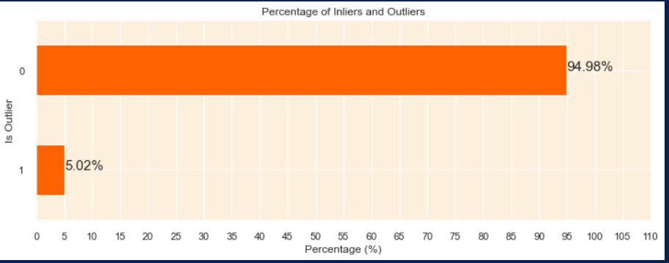
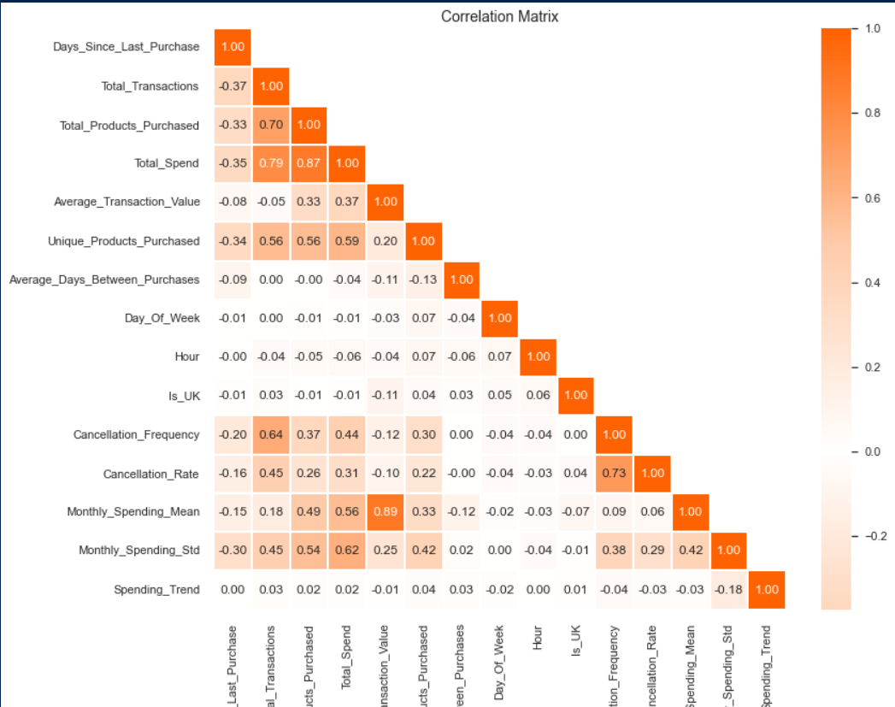
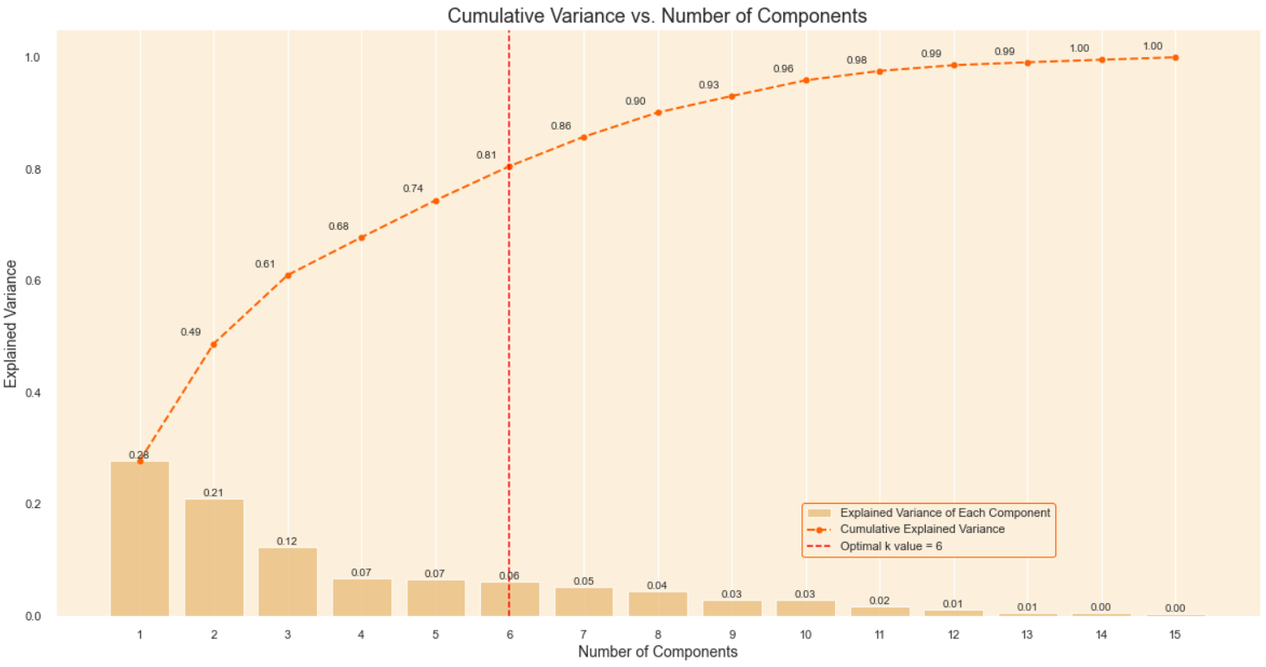
Modelling & Result

Slide 10
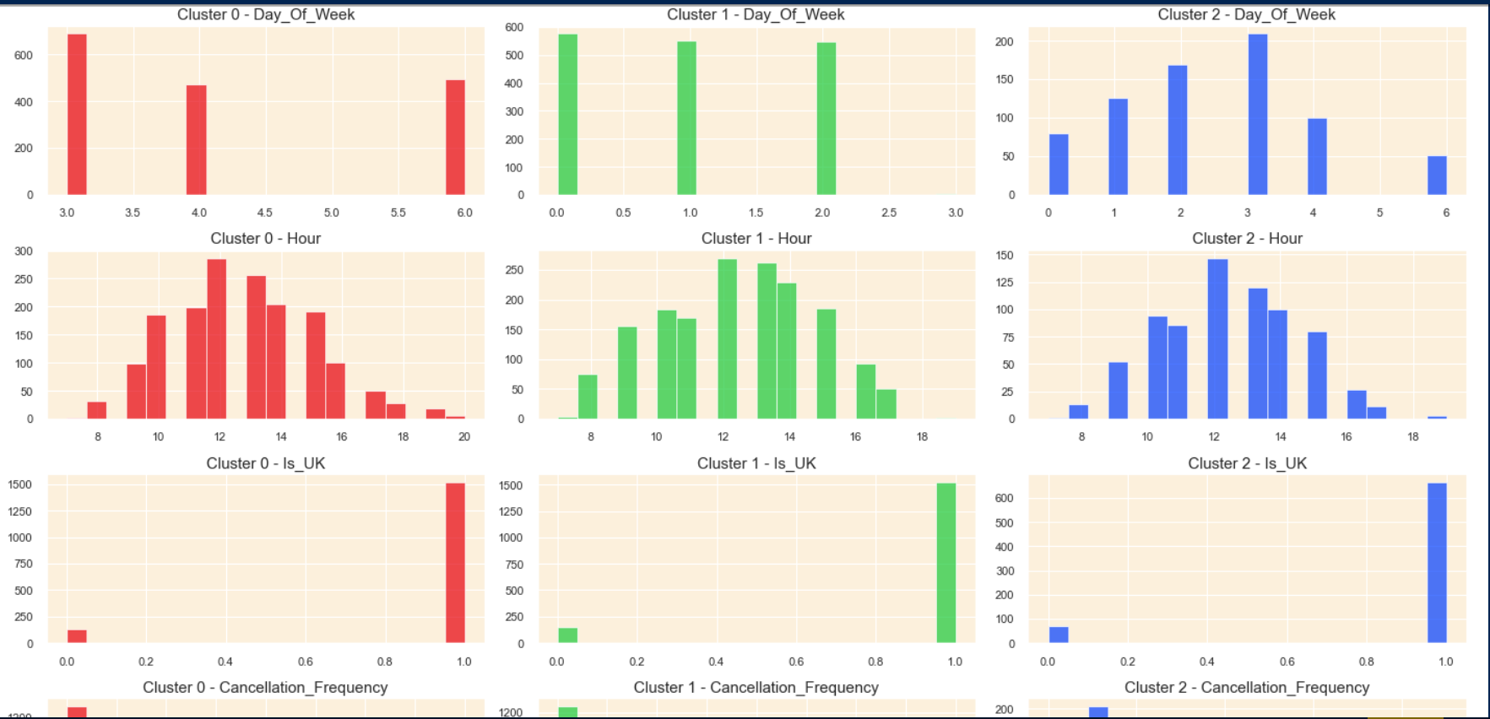
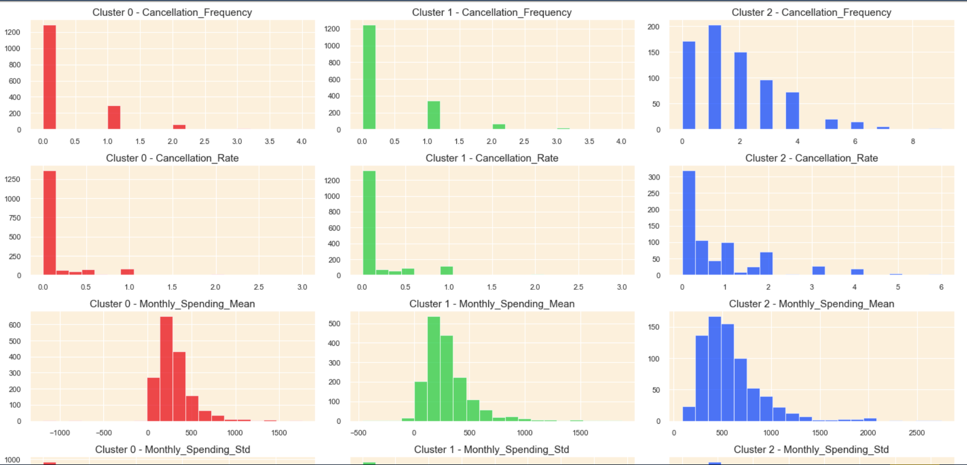
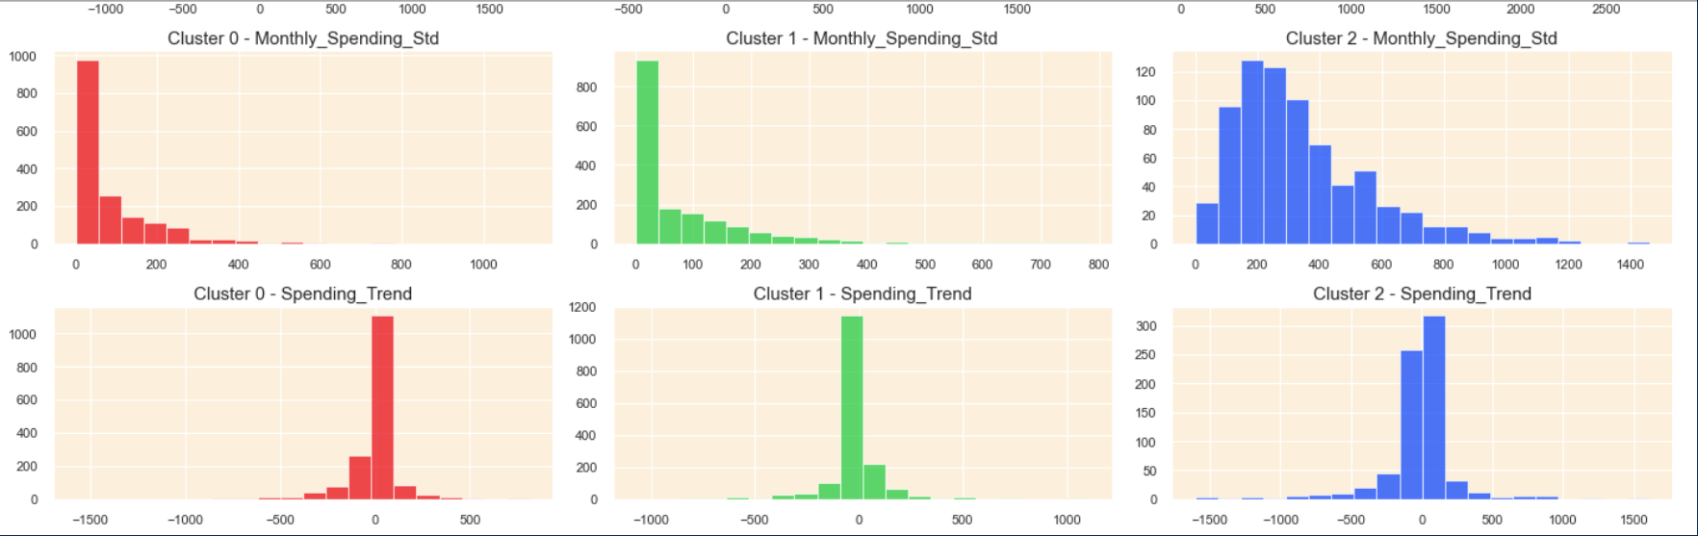
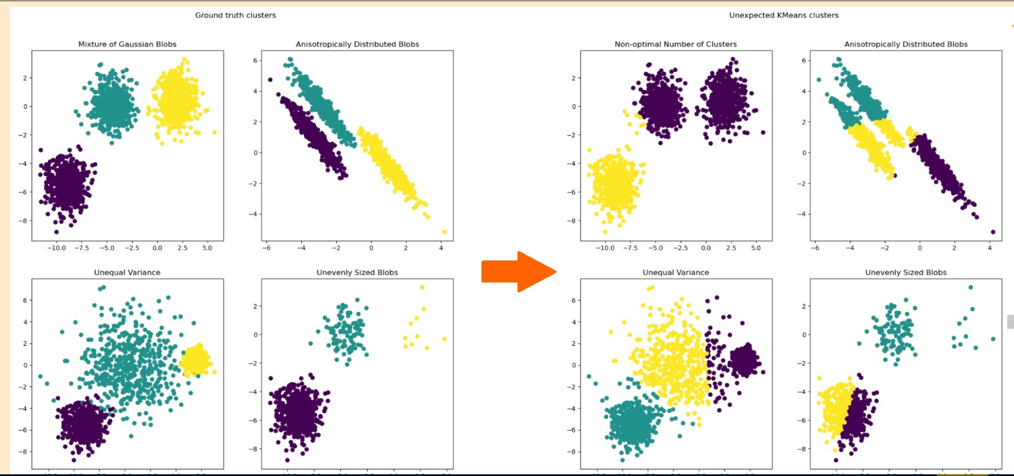
Modelling & Result

Slide 11

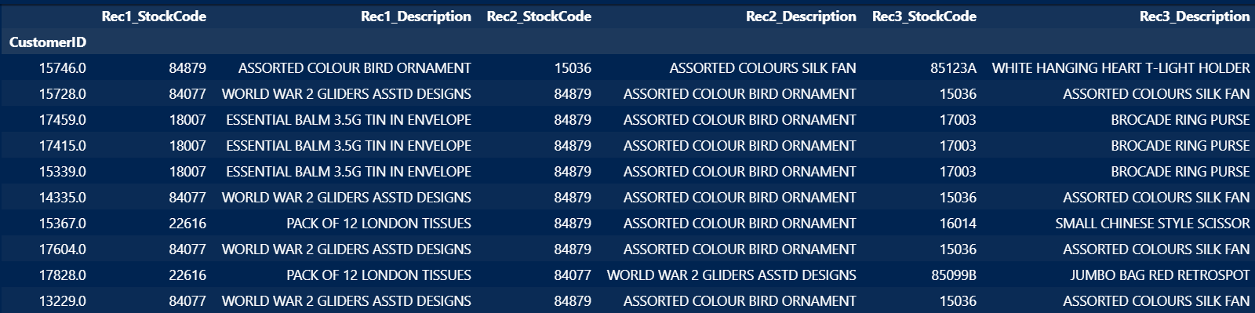
Conclusion
Cluster 0 - Casual Weekend Shoppers:Customers in this cluster usually shop less frequently and spend less money compared to the other clusters.They generally have a smaller number of transactions and buy fewer products.These customers have a preference for shopping during the weekends, possibly engaging in casual orwindow shopping.Their spending habits are quite stable over time, showing little fluctuation in their monthly spending.They rarely cancel their transactions, indicating a more decisive shopping behavior.When they do shop, their spending per transaction tends to be lower compared to other clusters.
Cluster 1 - Occasional Big Spenders:Customers in this cluster don't shop frequently but tend to spend a considerable amount when they do, buying a variety of products.Their spending has been on the rise, indicating a growing interest or investment in their purchases.They prefer to shop later in the day, possibly after work hours, and are mainly based in the UK.They have a moderate tendency to cancel transactions, which might be due to their higher spending; they perhaps reconsider their purchases more often.Their purchases are generally substantial, indicating a preference for quality or premium products.
Cluster 2 - Eager Early-Bird Shoppers:Customers in this cluster are characterized by their high spending habits. They tend to buy a wide array ofunique products and engage in numerous transactions.Despite their high expenditure, they have a tendency to cancel a significant portion of their transactions, possibly indicating impulsive buying behaviors.They usually shop during the early hours of the day, perhaps finding time before their daily commitments or taking advantage of early bird deals.Their spending patterns are quite variable, with high fluctuations in their monthly spending, indicating a less predictable shopping pattern.Interestingly, their spending trend is showing a slight decrease, which might signal a future change in their shopping habits.
Overall, this project highlights the importance of data-driven approaches in optimizing marketing strategies and driving business growth in the online retail sector. By effectively segmenting customers and providing personalized recommendations, businesses can enhance marketing efficacy, foster customer loyalty, and achieve sustainable growth in an increasingly competitive market landscape.

Slide 12


Notes:
Thank You !!

